Slide 1
Analyst Bonus Research
Year 2000 Bonus Planning for Commercial and Commercial Support Analysts

Slide 2
Concepts Discussed
How will the new program serve the business needs?
The combined analyst program must meet the development needs of commercial support groups in addition to commercial.
MSA bonus matrix is historically lower than Commercial.
Commercial Analyst bonus payments may be higher than Commercial Support Professional level bonus payments.

Slide 3
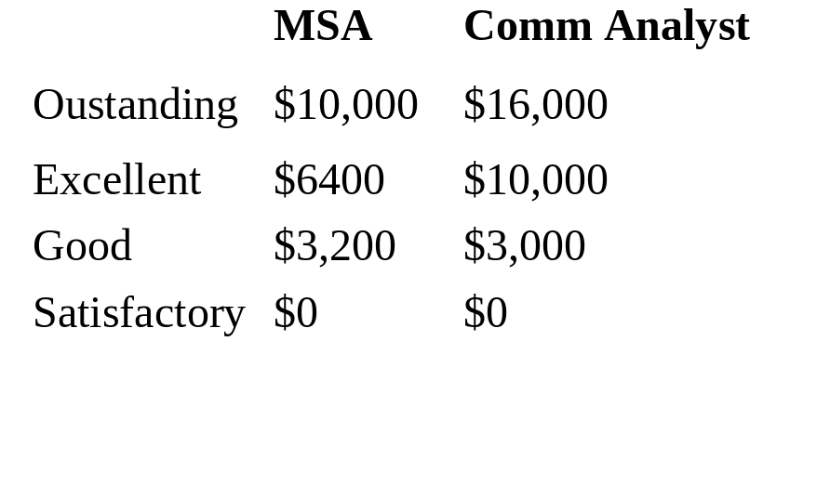
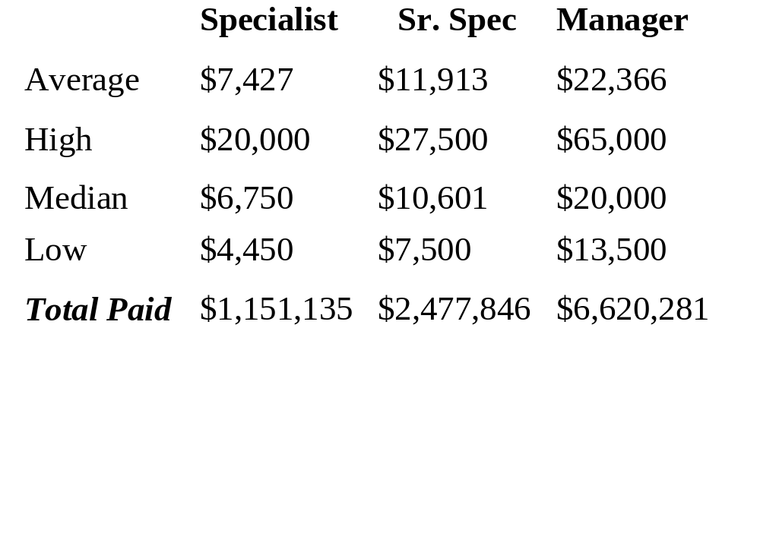
Bonus Matrix & Distribution Comparison
Analyst 1999 Bonus Matrix
1999 CS Professional Bonus Payouts
(Only the top 50% of paid bonuses*)
*Assumes the top 50% highest bonus amounts were
paid to the top performers - no performance rating
for most.

Slide 4
Additional Data Regarding 1999 Bonus
Analyst Data
CS Professional Data***
# of Specialists in top 50% 156
Total Specialists 443
% of Specialists with no bonus 30%
# of Sr. Specialists in top 50% 290
Total Sr. Specialists 527
% of Sr. Specialists with no bonus 21%
# of Managers in top 50% 297
Total Managers 728
% of Managers with no bonus 19%
MSA Hdct 1999 = 20
Comm Anal Hdct 1999 = 181
Comm Anal Hdct 2000 = 263
Performance Distribution
‘99 ‘00
Actual Preferred
Superior (‘00) 13
Outstanding 65 79
Excellent 99 92
Good 15 53
Satisfactory 2 26
NI/Issues (‘00) **
**There were four performance categories used in ‘99. Six performance
categories will be used in ‘00.
***Counts exclude recipients of no bonus and
specialized technical jobs (IT/Engineering)

Slide 5
Observations
The compression problem is avoided by the 2000 bonus matrix system.
Three bonus categories have been created for 2000; Commercial Associate, Commercial Analyst and Commercial Support Analyst.
In 1999, the CS Manager bonus matrix was higher than Commercial Analyst.
In 1999, the CS Sr. Specialist and Commercial Analyst bonus matrix was comparable.
A bell curve performance distribution for CS Analysts in 2000 will aid the prevention of inequitable bonus compression - must drive this at PRC.
Since there is an ability in the bonus model to differentiate the level of analyst bonus for CS and Comm there should be no compression problem.

